Slide 1
Floating Point Representation

Slide 2
Real Numbers
Numbers with fractions
Could be done in pure binary
  1001.1010 = 2³ + 2⁰ +2⁻¹ + 2⁻³ =9.625
Radix point: Fixed or Moving?
Fixed radix point: can’t represent very large or very small numbers.
Dynamically sliding the radix point -
  a range of very large and very small numbers can be represented.
In mathematics, radix point refers to the symbol used in numerical representations to separate the integral part of the number (to the left of the radix) from its fractional part (to the right of the radix). The radix point is usually a small dot, either placed on the baseline or halfway between the baseline and the top of the numerals. In base 10, the radix point is more commonly called the decimal point. ... From en.wikipedia.org/wiki/Radix_point

Slide 3
Floating Point
Sign bit
Biased
Exponent
Significand or Mantissa
+/- significand x 2^{exponent}
Point is actually fixed between sign bit and body of mantissa
Exponent indicates place value (point position)

Slide 4
Signs for Floating Point
Mantissa is stored in 2s compliment.
Exponent is in excess or biased notation.
Excess (biased exponent) 128 means
  8 bit exponent field
  Pure value range 0-255
  Subtract (2 ^{k-1 -} 1)to get correct value
  Range -128 to +127

Slide 5
Normalization
FP numbers are usually normalized
  exponent is adjusted so that leading bit (MSB) of mantissa is 1
  Since it is always 1 there is no need to store it
  (Scientific notation where numbers are normalized to give a single digit before the decimal point e.g. 3.123 x 10³)
In FP representation: not representing more individual values, but spreading the numbers.

Slide 6
IEEE 754
Standard for floating point storage
32 and 64 bit standards
8 and 11 bit exponent respectively
Extended formats (both mantissa and exponent) for intermediate results

Slide 7
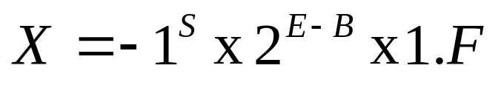
IEEE Floating-point Format
IEEE has introduced a standard floating-point format for arithmetic operations in mini and microcomputer, which is defined in IEEE Standard 754
In this format, the numbers are normalized so that the significand or mantissa lie in the range 1≤F<2, which corresponds to an integer part equal to 1
An IEEE format floating-point number X is formally defined as:
where S = sign bit [0→+, 1→−]
E = exponent biased by B
F = fractional mantissa

Slide 8
Biased Exponent Representation
How to represent a signed exponent? The Choices are
Sign + magnitude representation for the exponent
Two’s complement representation
Biased representation
IEEE 754 uses biased representation for the exponent ( 32 bit)
Value of exponent = val(E) = E – Bias (Bias is a constant)
Recall that exponent field is 8 bits for single precision
E can be in the range 0 to 255
E = 0 and E = 255 are reserved for special use
E = 1 to 254 are used for normalized floating point numbers
Bias = 127 (half of 254), val(E) = E – 127
val(E=1) = –126, val(E=127) = 0, val(E=254) = 127

Slide 9
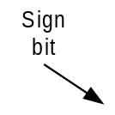



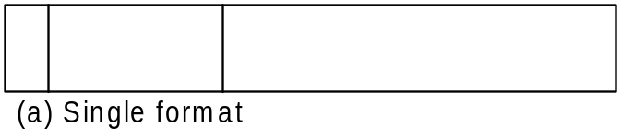
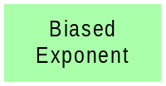


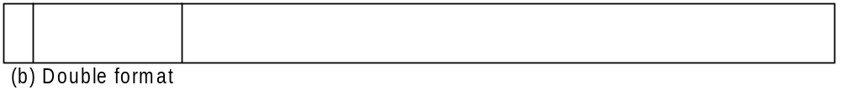
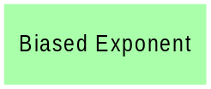
Two basics format are defined in the IEEE Standard 754
These are the 32-bit single and 64-bit double formats, with 8-bit and 11-bit exponent respectively
A sign-magnitude representation has been adopted for the mantissa; mantissa is negative if S =1, and positive if S =0

Slide 10
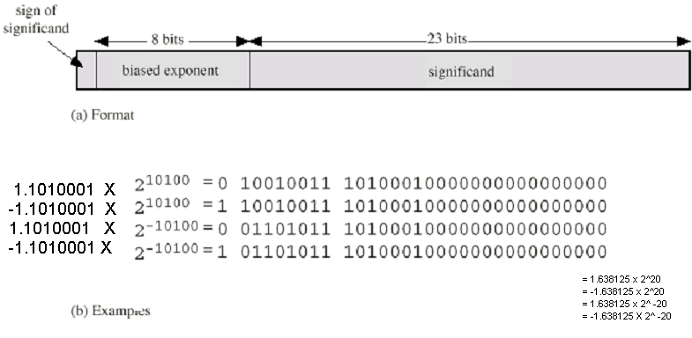
Floating Point Examples
negative
20
127 + 20 = 147
negative
normalized
-20
127 - 20 = 107
The bias equals to (2^{K-1} – 1) → 2⁸⁻¹ – 1 = 127

Slide 11












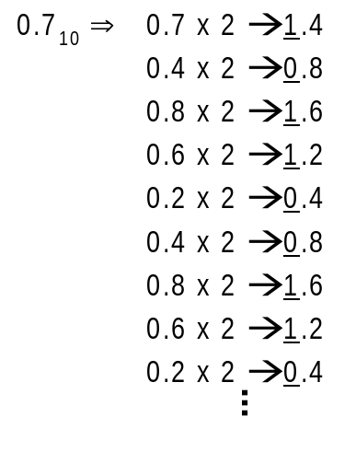





Example
Convert these number to IEEE single precision format:
Slides adapted from tan wooi haw’s lecture notes (FOE)

Slide 12
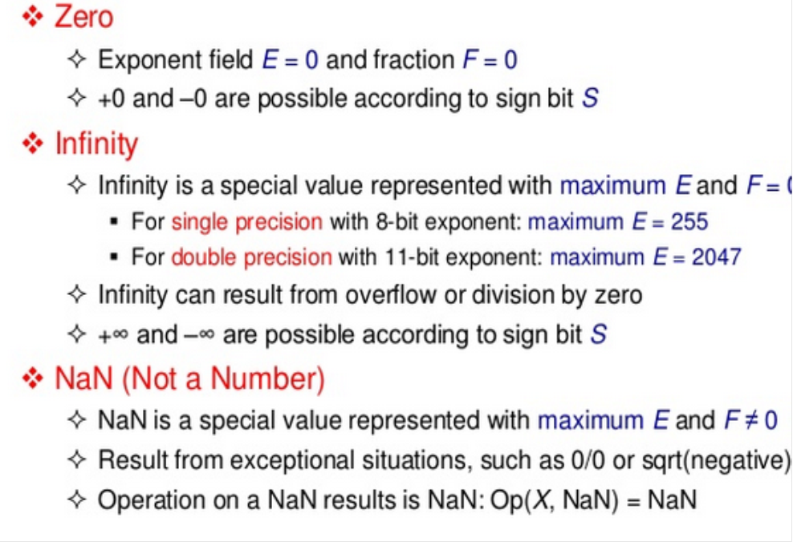

Slide 13
FP Arithmetic +/-
Check for zeros
Align significands (adjusting exponents)
Add or subtract significands
Normalize result

Slide 14
FP Arithmetic x/÷
Check for zero
Add/subtract exponents
Multiply/divide significands (watch sign)
Normalize
Round
All intermediate results should be in double length storage

Slide 15
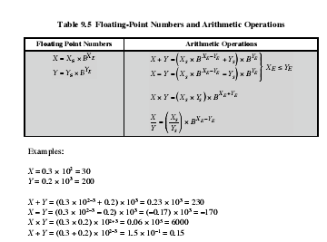
Floating-point Arithmetic (cont.)
Some basic floating-point arithmetic operations are shown in the table

Slide 16
Floating-point Arithmetic (cont.)
For addition and subtraction, it is necessary to ensure that both operand exponents have the same value
This may involves shifting the radix point of one of the operand to achieve alignment

Slide 17
Floating-point Arithmetic (cont.)
Some problems that may arise during arithmetic operations are:
i. Exponent overflow: A positive exponent exceeds the maximum possible exponent value and this may leads to +∞ or -∞ in some systems
ii. Exponent underflow: A negative exponent is less than the minimum possible exponent value (eg. 2⁻²⁰⁰), the number is too small to be represented and maybe reported as 0
iii. Significand underflow: In the process of aligning significands, the smaller number may have a significand which is too small to be represented
iv. Significand overflow: The addition of two significands of the same sign may result in a carry out from the most significant bit

Slide 18
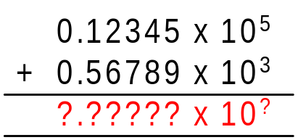
FP Arithmetic +/-
Unlike integer and fixed-point number representation, floating-point numbers cannot be added in one simple operation
Consider adding two decimal numbers:
A = 12345
B = 567.89
If these numbers are normalized and added in floating-point format, we will have
Obviously, direct addition cannot take place as the exponents are different

Slide 19
FP Arithmetic +/- (cont.)
Floating-point addition and subtraction will typically involve the following steps:
i. Align the significand
ii. Add or subtract the significands
iii. Normalize the result
Since addition and subtraction are identical except for a sign change, the process begins by changing the sign of the subtrahend if it is a subtract operation
The floating-point numbers can only be added if the two exponents are equal
This can be done by aligning the smaller number with the bigger number [increasing its exponent] or vice-versa, so that both numbers have the same exponent
Slides adapted from tan wooi haw’s lecture notes (FOE)

Slide 20
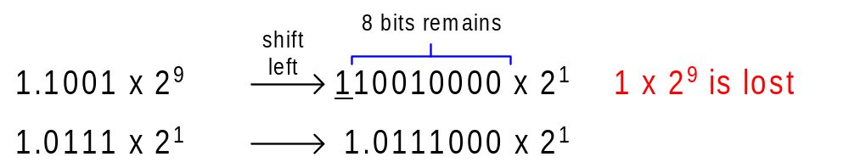
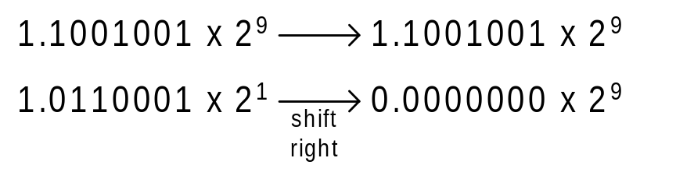
FP Arithmetic +/- (cont.)
As the aligning operation may result in the lost of digits, it is the smaller number that is shifted so that any lost will therefore be of relatively insignificant
Hence, the smaller number are shifted right by increasing its exponent until the two exponents are the same
If both numbers have exponents that differ significantly, the smaller number is lost as a result of shifting

Slide 21
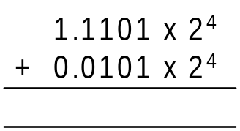


FP Arithmetic +/- (cont.)
After the numbers have been aligned, they are added together taking into account their signs
There might be a possibility of significand overflow due to a carry out from the most significant bit
If this occurs, the significand of the result if shifted right and the exponent is incremented
As the exponents are incremented, it might overflows and the operation will stop
Lastly, the result if normalized by shifting significand digits left until the most significant digit is non-zero
Each shift causes a decrement of the exponent and thus could cause an exponent underflow
Finally, the result is rounded off and reported

Slide 22
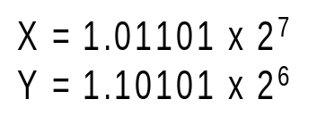
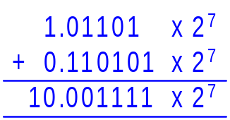
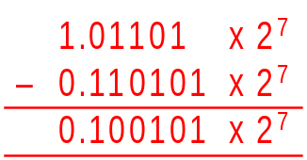
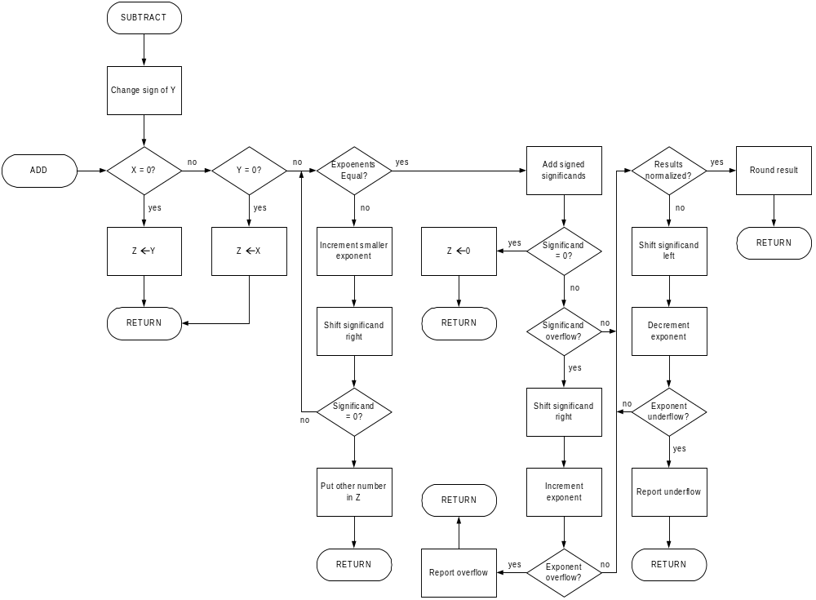

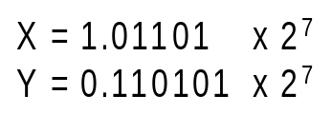








Slides adapted from tan wooi haw’s lecture notes (FOE)

Slide 23
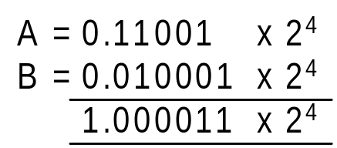

FP Arithmetic +/- (cont.)
Some of the floating-point arithmetic will lead to an increase number of bits in the mantissa
For example, consider adding these 5 significant bits floating-point numbers:
A = 0.11001 x 2⁴
B = 0.10001 x 2³
The result has two extra bit of precision which cannot be fitted into the floating point format
For simplicity, the number can be truncated to give 0.10000 x 2⁵

Slide 24
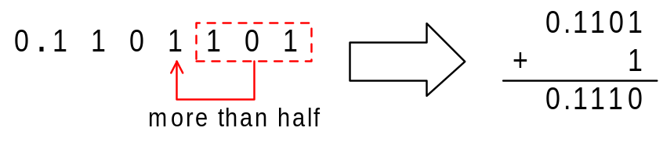

FP Arithmetic +/- (cont.)
Truncation is the simplest method which involves nothing more than taking away the extra bits
A much better technique is rounding in which if the value of the extra bits is greater than half the least significant bit of the retained bits, 1 is added to the LSB of the remaining digits
For example, consider rounding these numbers to 4 significant bits:
i. 0.1101101
extra bits → 0.0000101
LSB of retained bits → 0.0001

Slide 25
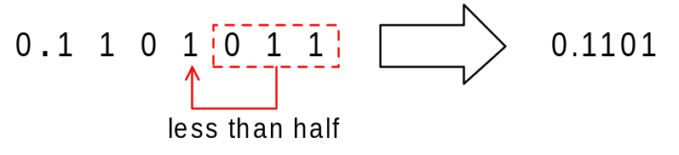

FP Arithmetic +/- (cont.)
ii. 0.1101011
extra bits → 0.0000011
LSB of retained bits → 0.0001
Truncation always undervalues the result, leading to a systematic error, whereas rounding sometimes reduces the result and sometimes increases it
Rounding is always preferred to truncation partly because it is more accurate and partly it gives rise to an unbiased error
Major disadvantage of rounding is that it requires a further arithmetic operation on the result

Slide 26
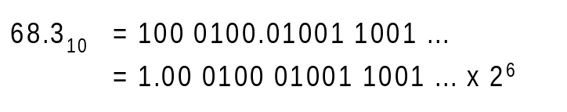
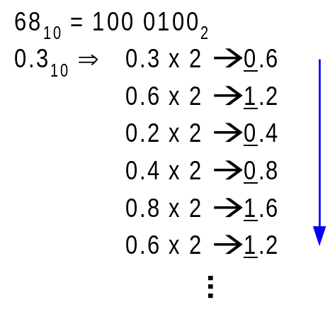
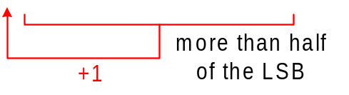
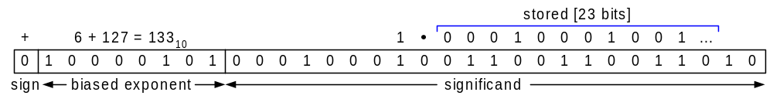
continue ...
ii. 68.3₁₀ + 12.2₁₀

Slide 27
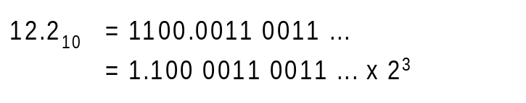
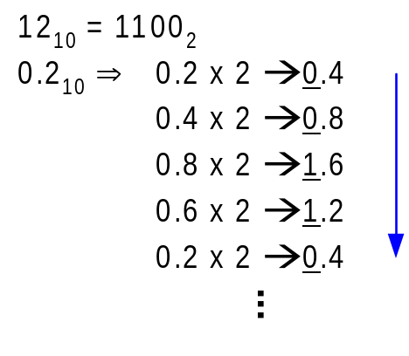
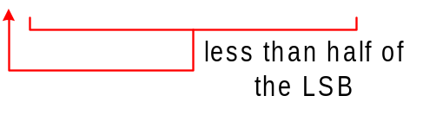

continue ...

Slide 28
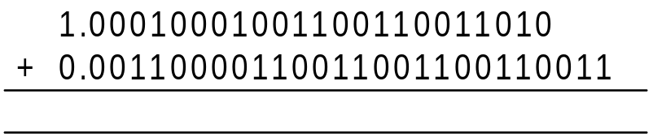
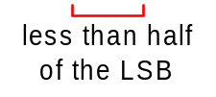
continue ...
Align the smaller number with the larger number by shifting it to the right [increasing the exponent]
ADD the mantissa
Store the result in IEEE single-precision format

Slide 29

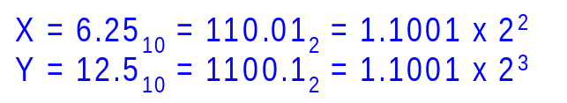
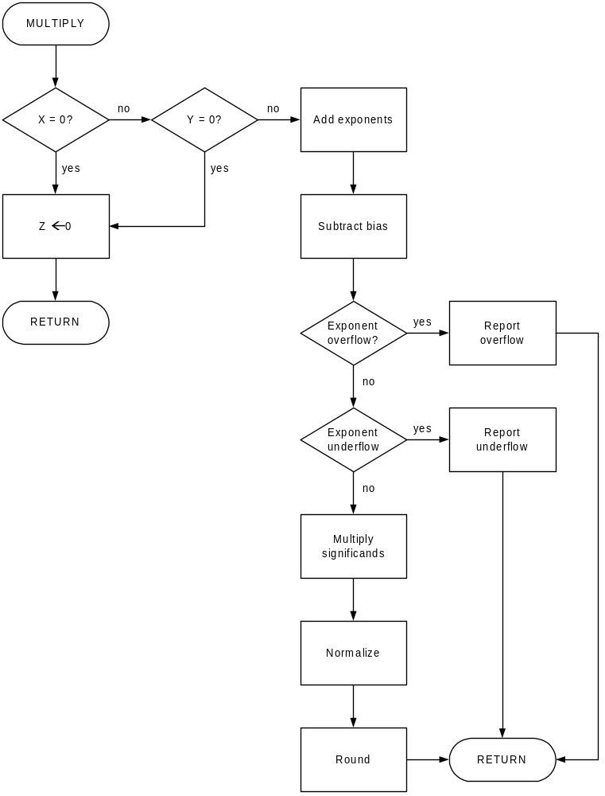
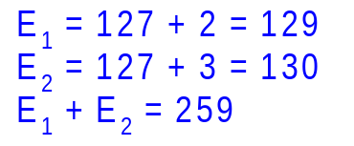

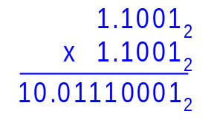
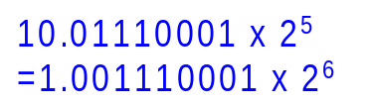
Floating-point Multiplication

Slide 30
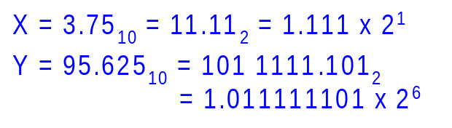

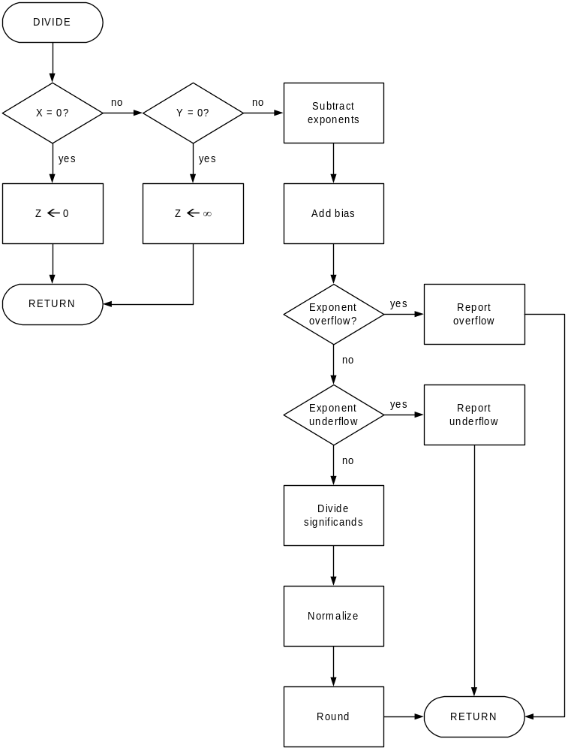
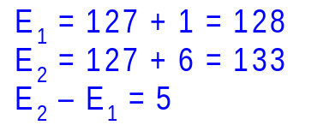

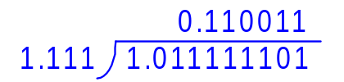
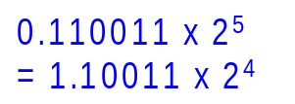
Floating-point Division

Slide 31
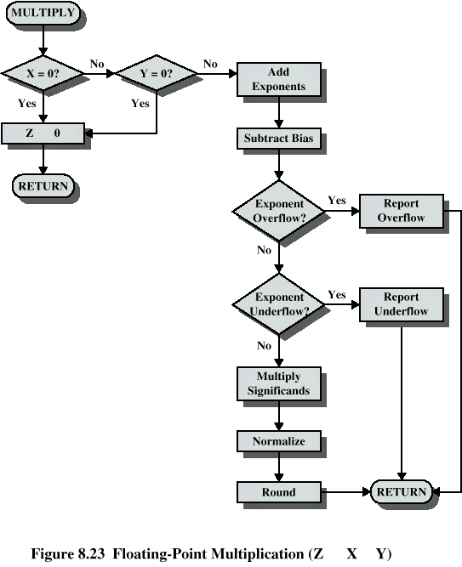
Floating Point Multiplication

Slide 32
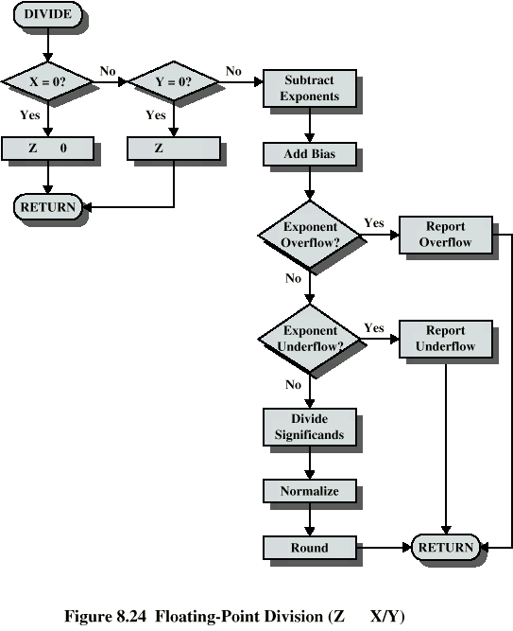
Floating Point Division

Slide 33
PROBLEM (1)
Express the number - (640.5)₁₀ in IEEE 32 bit and 64 bit floating point format

Slide 34
SOLUTION (1)….
IEEE 32 BIT FLOATING POINT FORMAT
MSB
8 bits
23 bits
sign
Biased
Exponent
Mantissa/Significand
(Normalized)
Step 1: Express the given number in binary form
(640.5) = 1010000000.1* 2⁰
Step 2: Normalize the number into the form 1.bbbbbbb
1010000000.1* 2⁰ = 1. 0100000001* 2⁹
Once Normalized, every number will have 1 at the leftmost bit. So IEEE notation is saying that there is no need to store this bit. Therefore significand to be stored is 0100 0000 0100 0000 0000 000 in the allotted 23 bits

Slide 35
SOLUTION (1)…….
Step 3: For the 8 bit biased exponent field, the bias used is 2^{k-1}-1 = 2⁸⁻¹-1 = 127 Add the bias 127 to the exponent 9 and convert it into binary in order to store for 8-bit biased exponent. 127 + 9 =136 ( 1000 1000)
Step 4: Since the given number is negative, put MSB as 1
Step 5: Pack the result into proper format(IEEE 32 bit)
1
1000 1000
0100 0000 0010 0000 0000 000

Slide 36
IEEE-754 Conversion Example
Represent -12.62510 in single precision IEEE-754 format.
• Step #1: Convert to target base. -12.62510 = -1100.101₂
• Step #2: Normalize. -1100.101₂ = -1.100101₂ × 2³
• Step #3: Fill in bit fields. Sign is negative, so sign bit is 1. Exponent is
in excess 127 (not excess 128!), so exponent is represented as the
unsigned integer 3 + 127 = 130. Leading 1 of significant is hidden, so
final bit pattern is:
1 1000 0010 . 1001 0100 0000 0000 0000 000

Slide 37
SOLUTION (1)…...
IEEE 64 BIT FLOATING POINT FORMAT
MSB
11 bits
52 bits
sign
Biased
Exponent
Mantissa/Significand
(Normalized)
Step 1: Express the given number in binary form
(640.5) = 1010000000.1* 2⁰
Step 2: Normalize the number into the form 1.bbbbbbb
1010000000.1* 2⁰ = 1. 0100000001* 2⁹
Once Normalized, every number will have 1 at the leftmost bit. So IEEE notation is saying that there is no need to store this bit. Therefore significand to be stored is 0100 0000 0100 0000 0000 0000 0000 0000 0000 0000 0000 0000 0000 in the allotted 52 bits

Slide 38
SOLUTION (1)…
Step 3: For the 11 bit biased exponent field, the bias used is 2^{k-1}-1 = 2¹¹⁻¹-1 = 1023 Add the bias 1023 to the exponent 9 and convert it into binary in order to store for 11-bit biased exponent. 1023 + 9 =1032 ( 1000 0001 000)
Step 4: Since the given number is negative, put MSB as 1
Step 5: Pack the result into proper format(IEEE 64 bit)
1
1000 0001 000
0100 0000 0010 0000 0000 0000 0000 0000 0000 0000 0000 0000 0000

Slide 39
Character Representation ASCII
ASCII (American Standard Code for Information Interchange) Code
MSB (3 bits)
0 1 2 3 4 5 6 7
LSB
(4 bits)
0
1
2
3
4
5
6
7
8
9
A
B
C
D
E
F
NUL
SOH
STX
ETX
EOT
ENQ
ACK
BEL
BS
HT
LF
VT
FF
CR
SO
SI
DLE
DC1
DC2
DC3
DC4
NAK
SYN
ETB
CAN
EM
SUB
ESC
FS
GS
RS
US
SP
!
“
#
$
%
&
‘
(
)
*
+
,
-
.
/
0
1
2
3
4
5
6
7
8
9
:
;
<
=
>
?
@
A
B
C
D
E
F
G
H
I
J
K
L
M
N
O
P
Q
R
S
T
U
V
W
X
Y
Z
[
\
]
m
n
‘
a
b
c
d
e
f
g
h
I
j
k
l
m
n
o
P
q
r
s
t
u
v
w
x
y
z
{
|
}
~
DEL

Slide 40
Control Character Representation (ASCII)
NUL Null
SOH Start of Heading (CC)
STX Start of Text (CC)
ETX End of Text (CC)
EOT End of Transmission (CC)
ENQ Enquiry (CC)
ACK Acknowledge (CC)
BEL Bell
BS Backspace (FE)
HT Horizontal Tab. (FE)
LF Line Feed (FE)
VT Vertical Tab. (FE)
FF Form Feed (FE)
CR Carriage Return (FE)
SO Shift Out
SI Shift In
DLE Data Link Escape (CC)
DC1 Device Control 1
DC2 Device Control 2
DC3 Device Control 3
DC4 Device Control 4
NAK Negative Acknowledge (CC)
SYN Synchronous Idle (CC)
ETB End of Transmission Block (CC)
CAN Cancel
EM End of Medium
SUB Substitute
ESC Escape
FS File Separator (IS)
GS Group Separator (IS)
RS Record Separator (IS)
US Unit Separator (IS)
DEL Delete
(CC) Communication Control
(FE) Format Effector
(IS) Information Separator

Slide 41
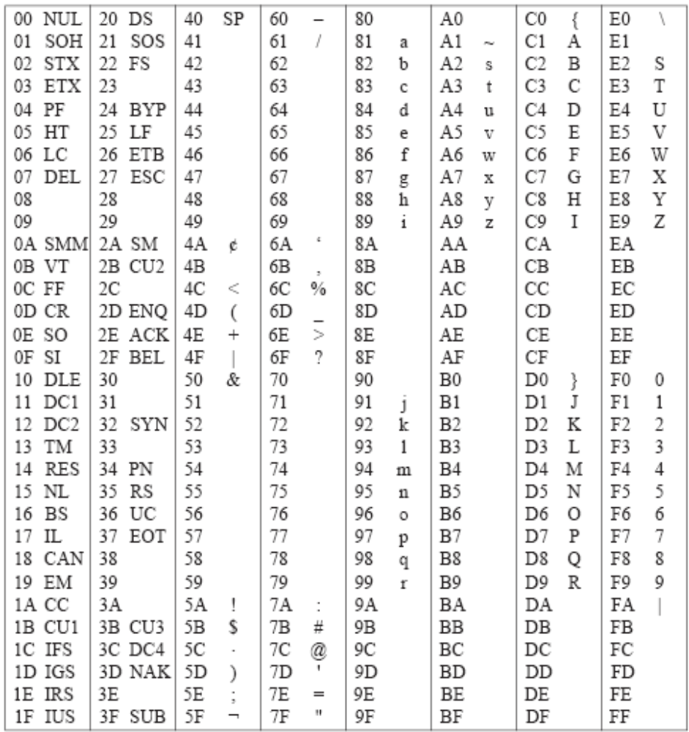
The EBCDIC character code, shown with hexadecimal indices

Slide 42
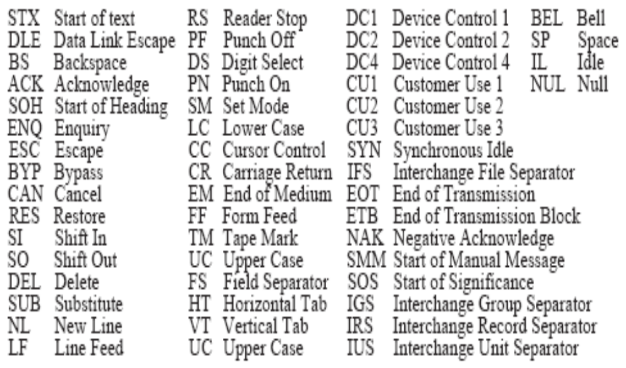
The EBCDIC control character representation

Slide 43
EBCDIC
The EBCDIC (Extended Binary Coded Decimal Interchange Code) is an extended binary code for IBM mainframes, mid-range computers, and peripheral devices that use 8 bits instead of the original 6-bit format.
Although EBCDIC is still used today, more modern encoding forms, such as ASCII and Unicode, exist. While all IBM computers use EBCDIC as their default encoding format, most IBM devices also include support for modern formats, allowing them to take advantage of newer features that EBCDIC does not provide.

Slide 44
Applications
EBCDIC is exclusively used on IBM machines such as mainframes, midrange personal computers, and peripheral devices. Since most IBM machines include extensive processing capabilities and some support for modern encoding languages, they are able to keep up and even outperform devices from other brands. However, most machines and operating systems depend on ASCII and Unicode as their default encoding format.

Slide 45
EBCDIC
Advantages and Disadvantages
EBCDIC is advantageous because it consists of an 8-bit character language rather than the old 6-bit character language found on punch card encoding systems.
This allows EBCDIC to provide IBM machines with support for a wide variety of functions that punch card encoding systems did not provide

Slide 46
ASCII
ASCII represents American Standard Code for Information Interchange. It is the standard binary code used to represent alphanumeric characters.
Alphanumeric characters are used for the transfer of information to and from the I/O devices and the computer. This standard helps seven bits to code 128 characters. However, there is an additional bit on the left that is always assigned 0. Therefore, there are 8 bits in total.
The ASCII code consists of 34 nonprinting characters and 94 characters used for various control operations. There are 26 uppercase letters A through Z, 26 lowercase letters a through z, numerals from 0 to 9, and 32 printable characters including %,*.
The control characters are used to route the data and arrange the printed text into a prescribed format.

Slide 47
In general, data is stored in a computer in the form of bits (1 or, 0). There are various coding schemes available specifying the set of bytes represented by each character.
ASCII − Stands for American Standards Code for Information Interchange. It is developed by American standards association and is the mostly used coding system. It represents characters using 7 bits and has includes 128 characters: upper and lowercase Latin alphabet, the numbers 0-9, and some extra characters).
Unicode (UTF) − Stands for Unicode Translation Format. It is developed by The Unicode Consortium. if you want to create documents that use characters from multiple character sets, you will be able to do so using the single Unicode character encodings. It provides 3 types of encodings.
UTF-8 − It comes in 8-bit units (bytes), a character in UTF8 can be from 1 to 4 bytes long, making UTF8 variable width.
UTF-16 − It comes in 16-bit units (shorts), it can be 1 or 2 shorts long, making UTF16 variable width.
UTF-32 − It comes in 32-bit units (longs). It is a fixed-width format and is always 1 "long" in length.

Slide 48

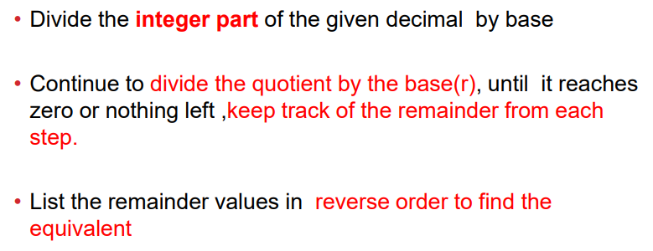
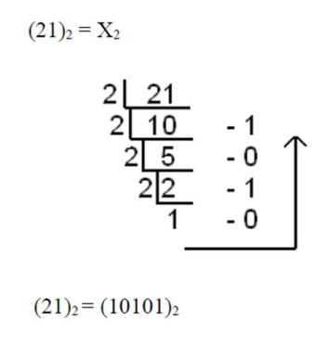
Reference

Slide 49
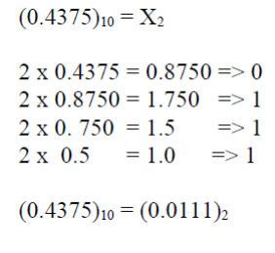
Fractional Part

